Slide 1
Stacks and Queues

Slide 2
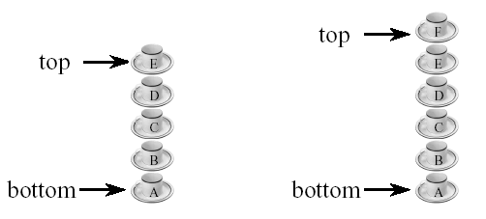
Stack
Stores a set of elements in a particular order
Stack principle: LAST IN FIRST OUT = LIFO
It means: the last element inserted is the first one to be removed
Example

Slide 3
Last In First Out
B
A
C
B
A
D
C
B
A
E
D
C
B
A
top
D
C
B
A
top
top
top
A
top

Slide 4
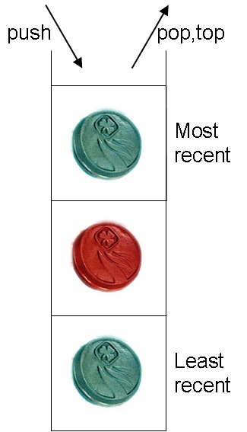
Stack Operations
The last item added is pushed (added) to the stack.
The last item added can be popped (removed) from the stack.
The last item added can be topped (accessed) from the stack.
These operations all take constant time: O(1).
A typical stack interface:
void push(Thing newThing);
void pop();
Thing top();

Slide 5
Basic Alg for Stack Push & Pop
PUSH(STACK,TOP,MAXSTK,ITEM)
If TOP=MAXSTK, then print OVERFLOW, and Return
Set TOP = TOP +1
Set STACK[TOP] = ITEM
Return
POP(STACK,TOP,MAXSTK,ITEM)
If TOP=0, then print UNDERFLOW, and Return
ITEM = Set STACK[TOP]
Set TOP = TOP - 1
Return

Slide 6
Stack Applications
String Conversion
Converting Infix to Postfix
Evaluation of Expression
Towers of Hanoi
Balancing symbols

Slide 7
Infix to postfix
Algorithm 1) Examine the next element in the input. 2) If it is an operand, output it. 3) If it is opening parenthesis, push it on stack. 4) If it is an operator, then i) If stack is empty, push operator on stack. ii) If the top of the stack is opening parenthesis, push operator on stack.

Slide 8
iii) If it has higher priority than the top of stack, push operator on stack. iv) Else pop the operator from the stack and output it, repeat step 4. 5) If it is a closing parenthesis, pop operators from the stack and output them until an opening parenthesis is encountered. pop and discard the opening parenthesis. 6) If there is more input go to step 1 7) If there is no more input, unstack the remaining operators to output.

Slide 9
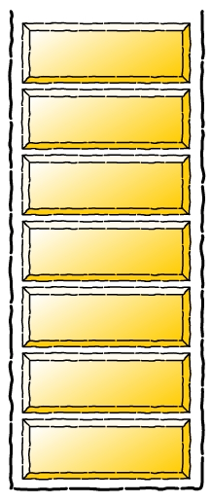
Infix to postfix conversion
infixVect
( a + b - c ) * d – ( e + f )
postfixVect

Slide 10
Infix to postfix conversion
stackVect
infixVect
a + b - c ) * d – ( e + f )
postfixVect
(

Slide 11
Infix to postfix conversion
stackVect
infixVect
+ b - c ) * d – ( e + f )
postfixVect
a
(

Slide 12
Infix to postfix conversion
stackVect
infixVect
b - c ) * d – ( e + f )
postfixVect
a
+
(

Slide 13
Infix to postfix conversion
stackVect
infixVect
- c ) * d – ( e + f )
postfixVect
a b
+
(

Slide 14
Infix to postfix conversion
stackVect
infixVect
c ) * d – ( e + f )
postfixVect
a b +
-
(

Slide 15
Infix to postfix conversion
stackVect
infixVect
) * d – ( e + f )
postfixVect
a b + c
-
(

Slide 16
Infix to postfix conversion
stackVect
infixVect
* d – ( e + f )
postfixVect
a b + c -

Slide 17
Infix to postfix conversion
stackVect
infixVect
d – ( e + f )
postfixVect
a b + c -
*

Slide 18
Infix to postfix conversion
stackVect
infixVect
– ( e + f )
postfixVect
a b + c - d
*

Slide 19
Infix to postfix conversion
stackVect
infixVect
( e + f )
postfixVect
a b + c – d *
-

Slide 20
Infix to postfix conversion
stackVect
infixVect
e + f )
postfixVect
a b + c – d *
(
-

Slide 21
Infix to postfix conversion
stackVect
infixVect
+ f )
postfixVect
a b + c – d * e
(
-

Slide 22
Infix to postfix conversion
stackVect
infixVect
f )
postfixVect
a b + c – d * e
+
(
-

Slide 23
Infix to postfix conversion
stackVect
infixVect
)
postfixVect
a b + c – d * e f
+
(
-

Slide 24
Infix to postfix conversion
stackVect
infixVect
postfixVect
a b + c – d * e f +
-

Slide 25
Infix to postfix conversion
stackVect
infixVect
postfixVect
a b + c – d * e f + -

Slide 26
Evaluating Expression
Expression: 5 3 - 6 + 8 2 / 1 2 + - *
3
5
6
2
3
5
3
5
8
8
2
8
8
5
2
8
Execute 5 - 3
Execute 2 + 6
2
1
4
8
3
4
8
1
4
8
1
8
4
8
8
Execute
1 + 2
Execute
4 - 3
Execute
8 * 1
Execute 8 / 2

Slide 27
Algorithm for evaluating expression
By using a stack algorithm
Initialize an empty stack
Repeat the following until the end of the expression is encountered
Get the next token (const, var, operator) in the expression
Operand – push onto stack Operator – do the following
Pop 2 values from stack
Apply operator to the two values
Push resulting value back onto stack
When end of expression encountered, value of expression is the (only) number left in stack

Slide 28
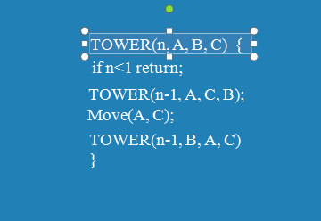
Towers of Hanoi

Slide 29
Algorithm for Balanced Symbol Checking
Make an empty stack
read symbols until end of file
if the symbol is an opening symbol push it onto the stack
if it is a closing symbol do the following
if the stack is empty report an error
otherwise pop the stack. If the symbol popped does not match the closing symbol report an error
At the end of the file if the stack is not empty report an error

Slide 30
Queue
Two types of queue:-
Simple Queue
Circular Queue

Slide 31
Basic Insert Alg for Queue
QINSERT(QUEUE,N,FRONT,REAR,ITEM)
If FRONT = 1 and REAR = 1, or if FRONT = REAR + 1, then Write OVERFLOW and Return
If FRONT = NULL, then
SET FRONT = 1 and REAR = 1
Else If REAR = N, then:
SET REAR = 1
Else
SET REAR = REAR+1
Set QUEUE[REAR] = ITEM
Return

Slide 32
Basic Delete Alg for Queue
QDELETE(QUEUE,N,FRONT,REAR,ITEM)
If FRONT = NULL, then Write UNDERFLOW and Return
Set ITEM = QUEUE[FRONT]
If FRONT = REAR, then
SET FRONT = NULL and REAR = NULL
Else If FRONT = N, then:
SET FRONT = 1
Else
SET FRONT = FRONT+1
Return

Slide 33
Working of a simple queue
-1
Elements:
a
b
c
d
e
f
g
h
0 | 1 | 2 | 3 | 4 | 5 | 6 | 7
F
Process:
R
Animated by S.Graceline Jasmine

Slide 34
Working of a circular queue
0
F =
R
= 0
Elements:
a
b
c
d
e
f
g
h
i
j
1 | 2 | 3 | 4 | 5 | 6 | 7 | 8
F
Process:
R
Animated by M.Jayasudha

Slide 35
Priority Queue
A priority queue is a collection of elements such that each element has been assigned a priority and such that the order in which elements are deleted and processed comes from the following rules:
An element of higher priority are processed before any element of lower priority.
Two elements with the same priority are processed according to the order in which they were added to the queue.

Slide 36
Array representation of a priority queue
Use separate queue foe each level of priority.
Each such queue will appear in its own circular array and must have its own pair of pointers, FRONT and REAR.
If each queue is allocated the same amount of space, a two-dimensional array QUEUE can be used instead of linear arrays.

Slide 37
Example for Priority Queue
Front[K] and REAR[K] contain, respectively, the front and rear elements of row K of QUEUE.
Front
Rear
1 | 2 | 3 | 4 | 5 | 6
2
1
0
5
4
2
3
0
1
4
1
2
3
4
5
 | AAA
BBB | CCC | XXX
FFF |  |  |  | DDD | EEE
 |  |  | GGG

